Slide 1


Flexible compensation structure (Salary Packaging) for FY 2012-13
Payroll Team – FICO SAP Labs India

Slide 2
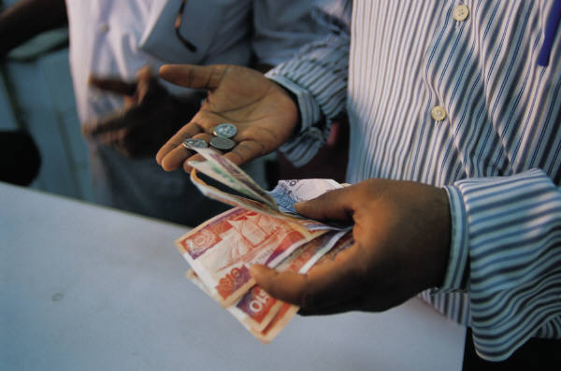
Salary Structure
This Compensation plan provides you the flexibility to structure your salary from within a given choices
Overall the salary is defined as:
Base Salary
Basic
Flexi Compensation
Allowances
Benefits Allowance
Superannuation Allowance
Retirement Benefits
PF
Gratuity
Variable Pay
Base Salary is split into 2 major components:
Basic Salary – 35%
Flexible Compensation – 65%

Slide 3

Flexible Compensation – 65%
Flexible Compensation makes up to 65% of your Base Salary
This part comprises of the following components:
House Rent Allowance (HRA)
Medical Reimbursement
Leave Travel Reimbursement (LTR)
Children Education Allowance (CEA)
Professional Development Allowance (PDA)
Car lease allowance
Telephone Reimbursement
Transport allowance
Special Allowance
Employees can plan their salary structure based on the above listed components to suit their requirements
The limits and tax benefits for each of the above components are listed in the following slides

Slide 4

House Rent Allowance - HRA
HRA
This is one of the best tax saving options, provided the employee stays in a rented house.
The tax benefit is calculated as least of the following:
Actual HRA/Rent paid
40% of Basic Salary
Rent paid minus 10% of Basic Salary
Recommended to keep this allowance at 40% of basic salary*
This will allow you to take the maximum benefit possible under HRA
*Note: Please note that the employees who are staying at Delhi can keep their HRA maximum up to 50% of their Basic salary.

Slide 5

Medical Reimbursement
Medical Reimbursement
Medical Reimbursement will be paid to the maximum of INR15,000 per annum.
The amount is paid against submission of original bills and Tax benefit is provided only to the extent of submitted original bills, incurred in the financial year.
Bills can be for any medicines purchased, doctors fee, medical checkup, for you and your dependents.
No hospitalization expenses are allowed under this category.
For Spectacle bills, Power card or Doctor Prescription is required
Un-claimed medical reimbursement amount will be paid to employee as a Taxable Allowance at the end of Financial year (March month)

Slide 6

Leave Travel Reimbursement
LTA
Leave Travel Reimbursement will be paid to the maximum of INR 60,000 per annum
Tax benefit will be given for 2 journeys in a block of 4 years, as per the Income Tax rules (the present block is Jan 2010-Dec 2013)
One journey is considered as one round trip, anywhere in India, starting from the place of your work
Original Tickets have to be submitted to claim the tax benefit
The amount is paid against submission of original bills and Tax benefit is provided only to the extent of submitted original bills, incurred in the financial year.
Un-claimed leave travel reimbursement amount will be paid to employee as a Taxable Allowance at the end of financial year (March month)

Slide 7

Professional Development Allowance - PDA
PDA
Professional Development Allowance can be utilized for the following:
To pay course fees for any further studies
To buy books or CD’s
To take up any memberships or certification courses
All the above should be in line with your nature of Job and should be approved by your respective Manager
The amount will be paid directly to the vendor or to the institution
This amount is not shown in the employees income statement
Any employee opted for PDA and not able to utilize the same, such amount will be paid back to employee along with March salary and the same is taxable

Slide 8

Car lease Allowance
Car lease Allowance
This component is applicable for employees who have availed a car under company car lease scheme (Existing Car Lease Policy and New Racer Policy)
Employee portion of EMI amount will be parked under this component. Employee should not input any amount here since payroll will fill this in
Employee will get a tax benefit for the amount mentioned under car lease allowance
Employee will get petrol allowance based on their eligibility (this allowance will not be paid for those who have availed a car under racer policy)
Perquisite on car is taxable in the hands of employee

Slide 9
Telephone Reimbursement
Telephone Expense Reimbursement
Eligible employees can set the limit up to INR 24,000/- per annum under this component
The amount is paid against submission of bills only
Employee can claim this reimbursement for one Landline and one Mobile phone
Employees have to submit original bills along with proof of payment
In case of separation, un-utilized telephone reimbursement amount will be paid to employee during last month payroll
This reimbursement facility (landline and mobile) is not available for those who have a Company provided Landline or Company Provided Mobile phone (including black berry)
Mobile phone should be in the name of employee only
Landline should be located in the city where the employee resides (basically where SAP offices are located)
Un-utilized amount will be paid back to the employee as “Taxable balance payment” at the end of the financial year

Slide 10
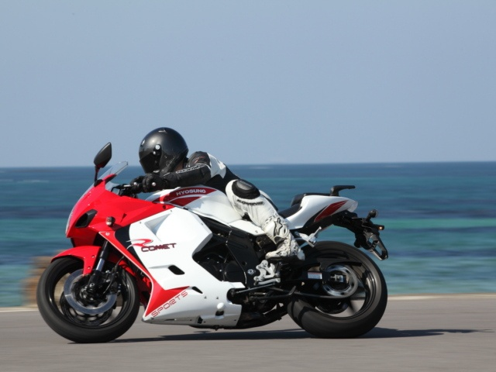
Transport Allowance
Transport Allowance
Eligible for those who commute on their own transport.
Employees who use company shuttle services are not eligible.
Employees who have availed the car lease scheme including racer policy are not eligible to claim this benefit
Maximum eligibility and deduction is Rs 9600/- per annum for those who are eligible

Slide 11
Children Education Allowance
CEA
INR100/- per child per month to a maximum of 2 children will be paid as Children Education Allowance
Copies of the Fee receipts have to be submitted for claiming the tax benefit

Slide 12

Special Allowance
Special Allowance
This is the balance amount out of your Flexible Compensation after allocating for other component
This allowance is fully taxable

Slide 13

Thank You!
E-mail – LabsIndia.payroll@sap.com
Phone – Bangalore: 7300
Gurgaon :7724

